Slide 1



ARTIFICIAL INTELLIGENCE AND MACHINE LEARNING
WEEK 1

Slide 2

Outline
INTRODUCTION TO
PYTHON
PYTHON
PYTHON

Slide 3





OUTLINE
WHY PYTHON
ADVANTAGES
DISADVANTAGES
PYTHON OR R
IDE

Slide 4


WHY PYTHON?
PYTHON IS EASY TO IMPLEMENT
Development time is quick
Debugging is straight forward
Readability is emphasized
Execution of python code is slow
Python was created for computer scientists, not data scientists

Slide 5


WHY PYTHON?
Python is open source
There are tons of packages freely available
Python is not restricted to data science
You can use packages to write video games or use your webcam

Slide 6
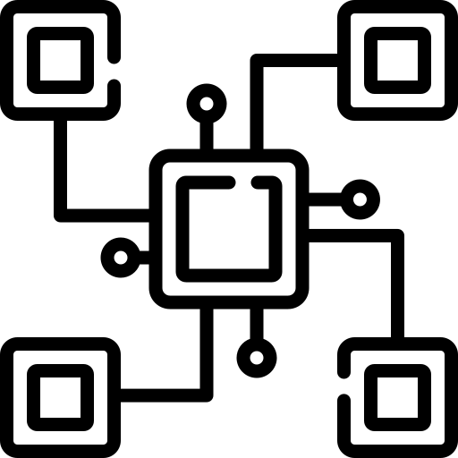



PYTHON OR R?
Python and r are both very popular among data scientists
Proficiency in concepts is more important than language choice
R is a little better if you’re only doing statistics work
If you need to write broad programs, python is the clear winner

Slide 7

IDE
THERE ARE MANY POPULAR PYTHON IDES
PyCharm
Jupyter notebooks
sypder
It is possible to use python without an IDE
If you have used Rstudio, then spyder is the closest
WE WILL USE JUYPTER NOTEBOOKS
Communication of ideas is easiest with juypter
To get access to this we will use Anaconda

Slide 8

Outline
FUNCTIONS

Slide 9

Outline
FLOW CONTROL

Slide 10

QUESTION & ANSWER

